Slide 1
British Airlines Reviews
Using Tableau

Slide 2
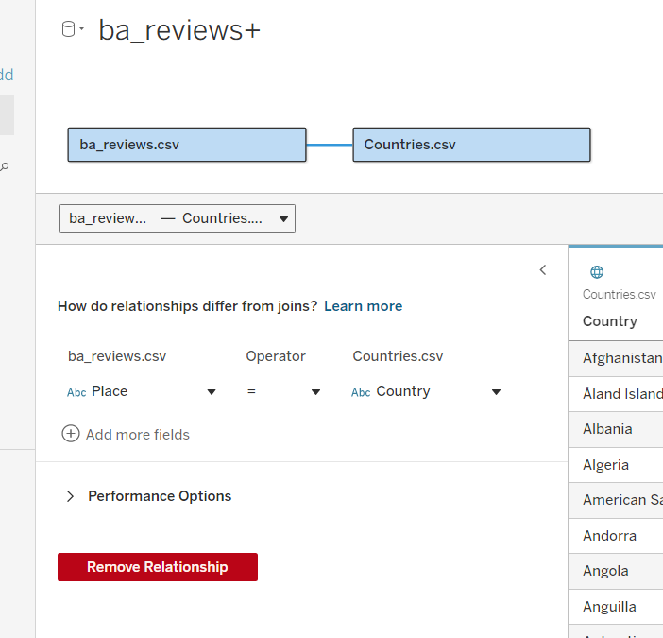
Steps
Load data.
Create relationship between datasets.
Go to worksheet to built charts and dashboard.

Slide 3
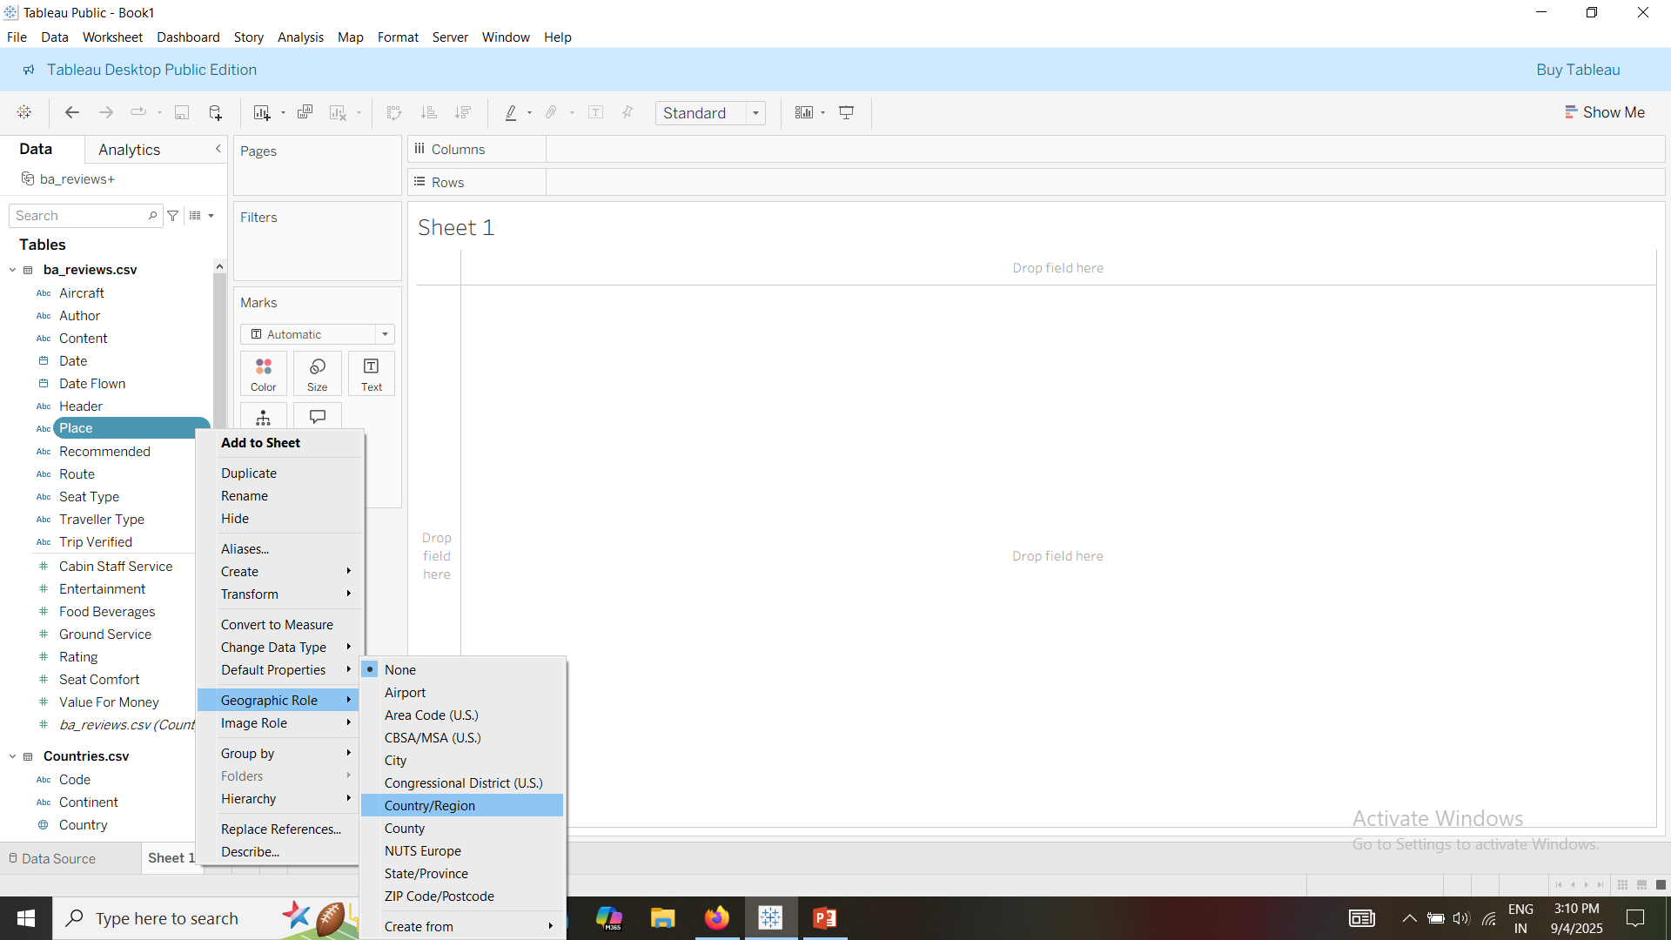
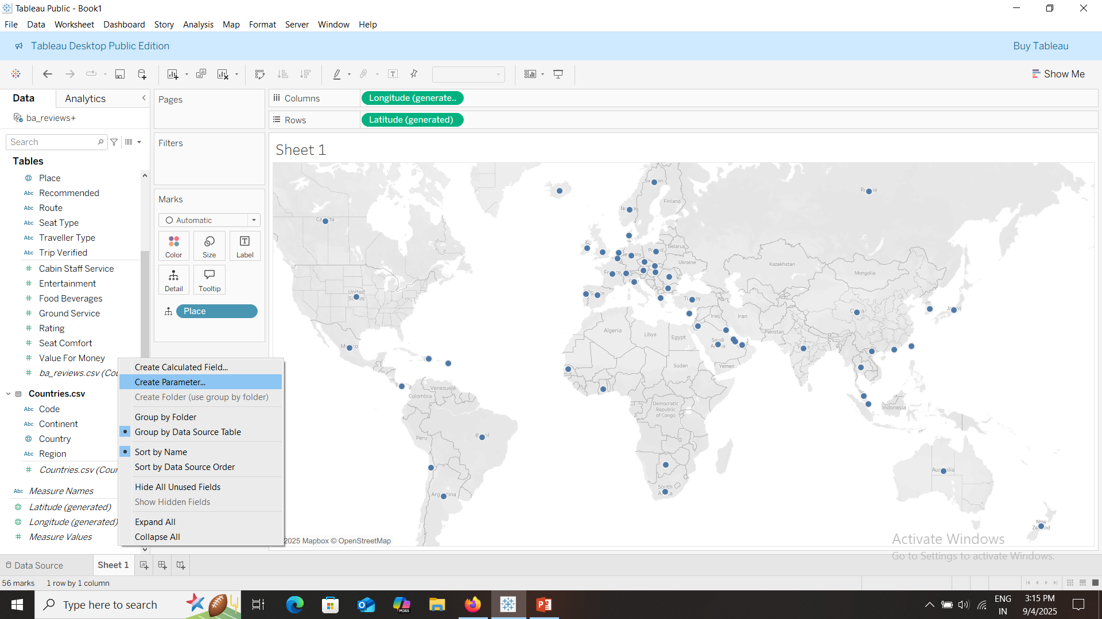
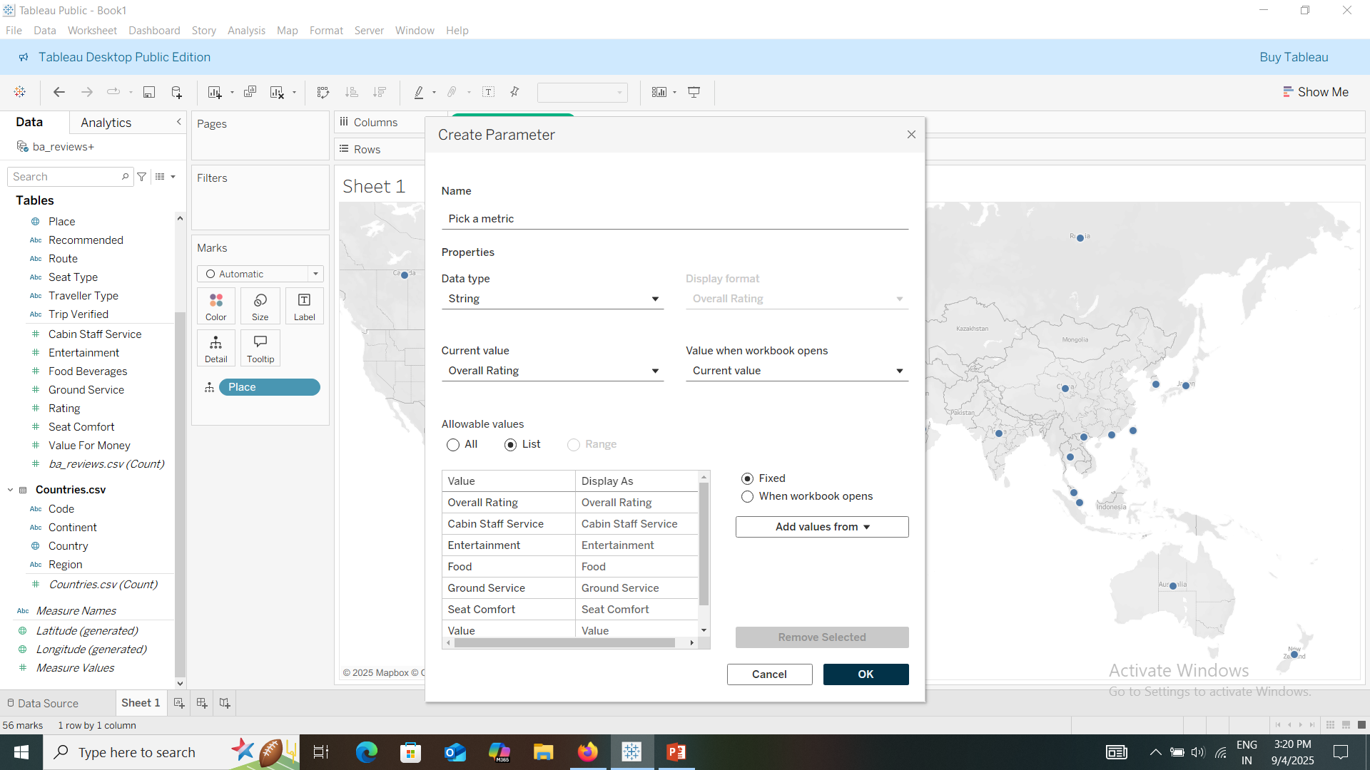
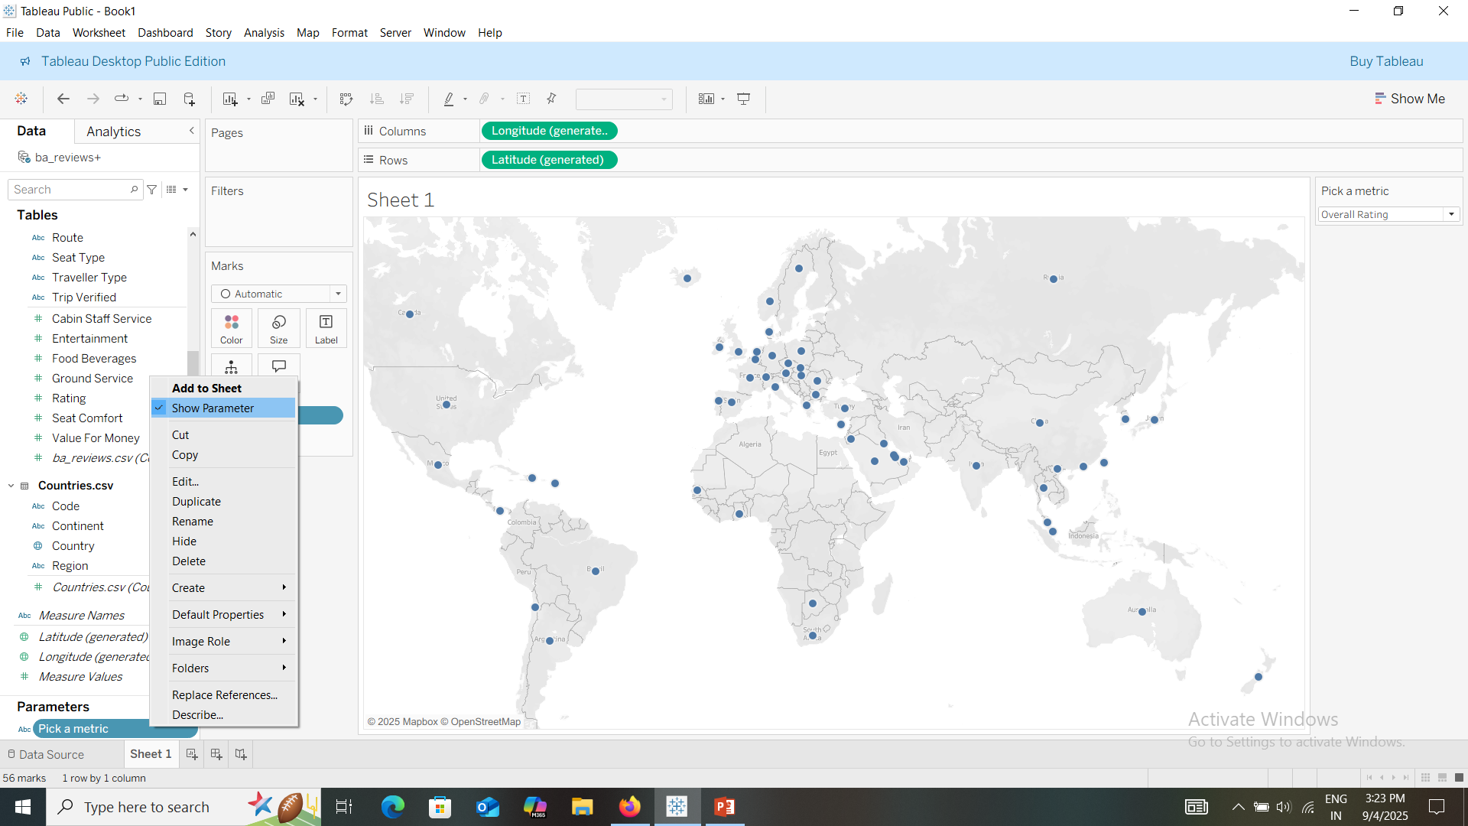
Built a map chart
Change data types of place to geographical region.
Double click on place to create a map.
Create a parameter to have metrics to check data.

Slide 4
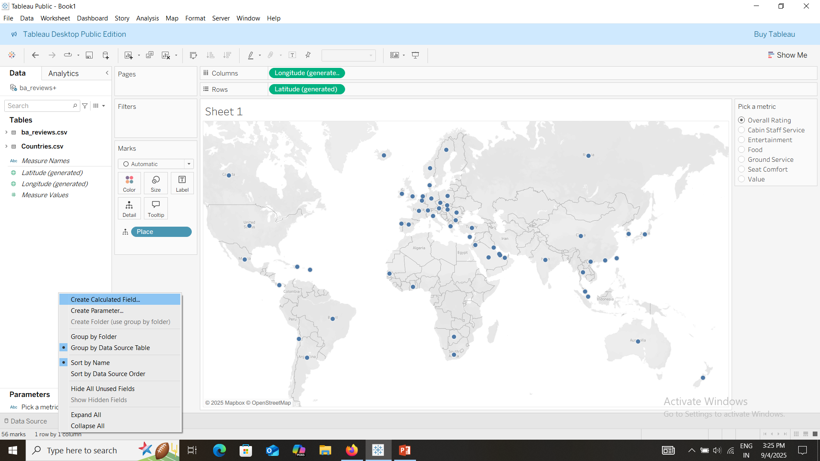
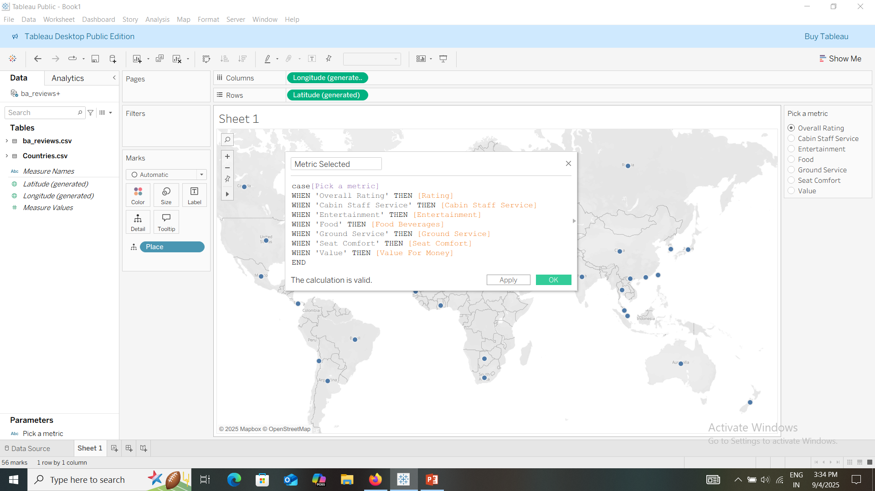
Create calculated field
Create calculated field

Slide 5
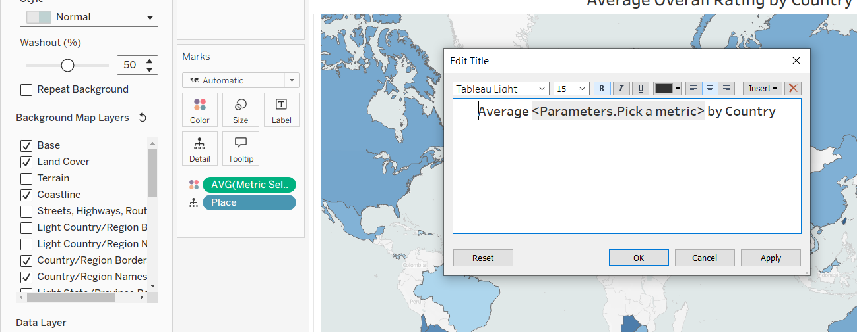
Add the metric to colors.
Tidy up the map by selecting the option map.
Edit the title of the chart.

Slide 6
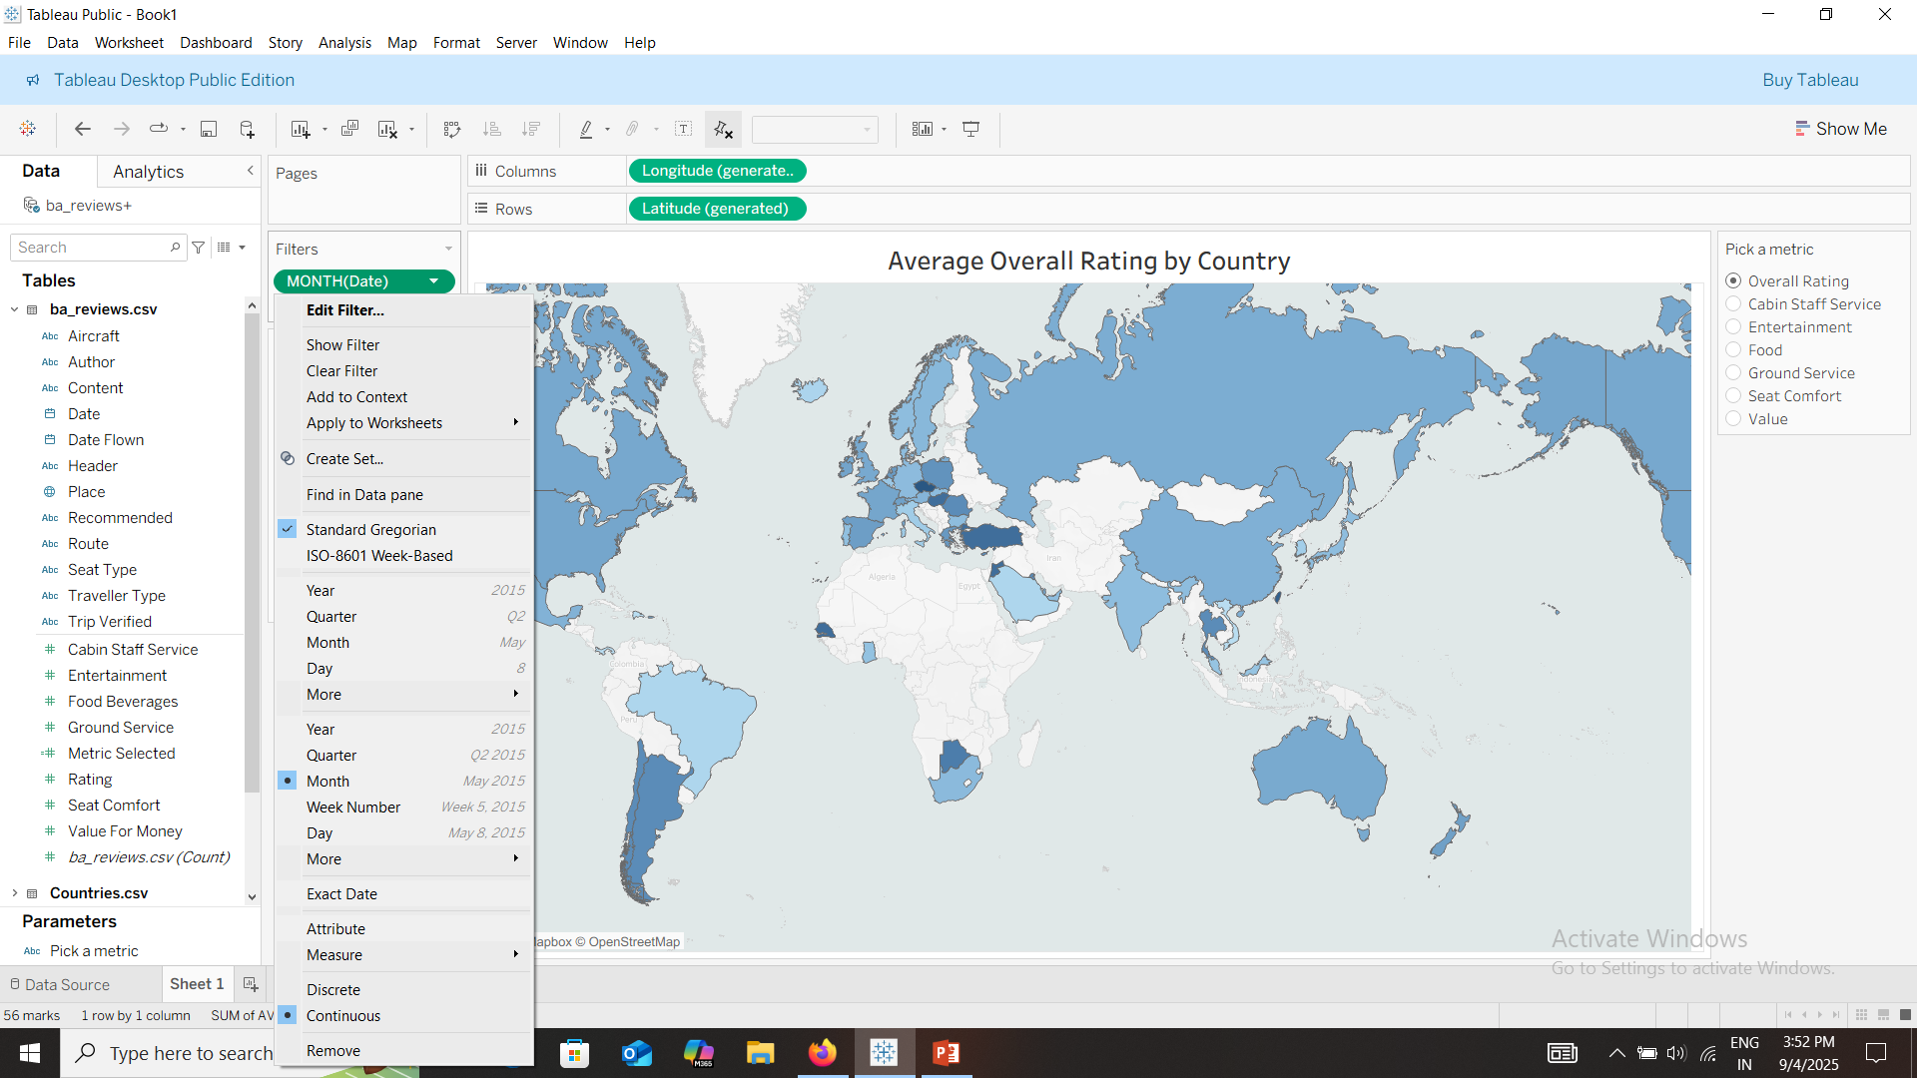
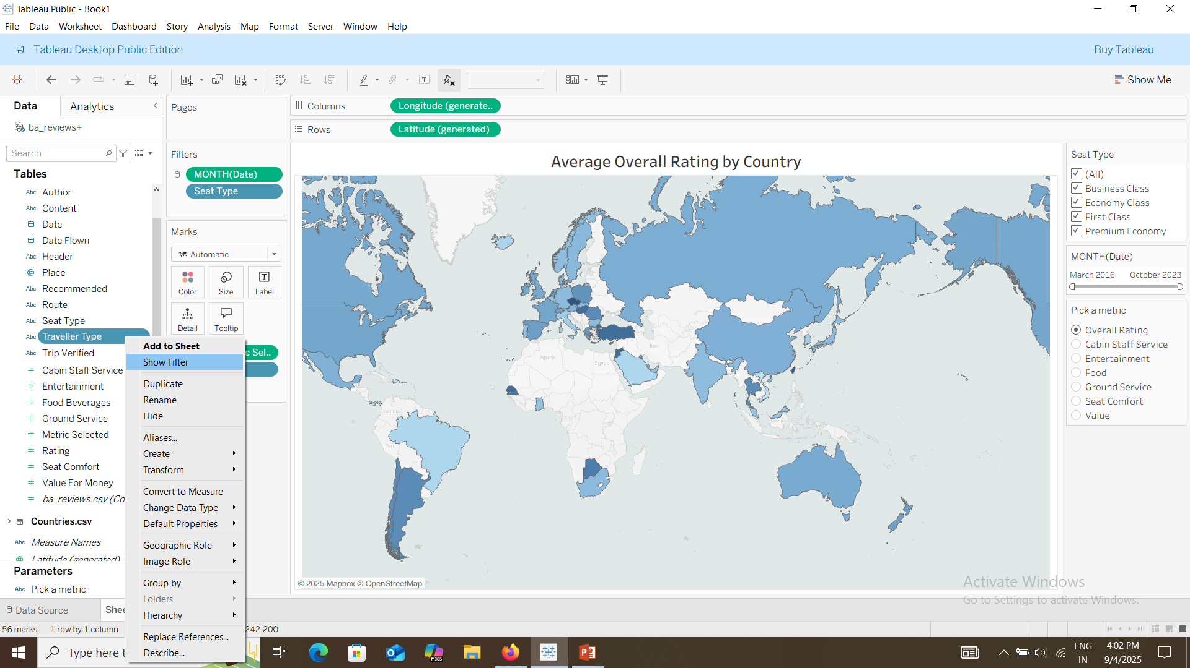
Add filters: date as months in continuous.
Add seat type and traveler type.

Slide 7
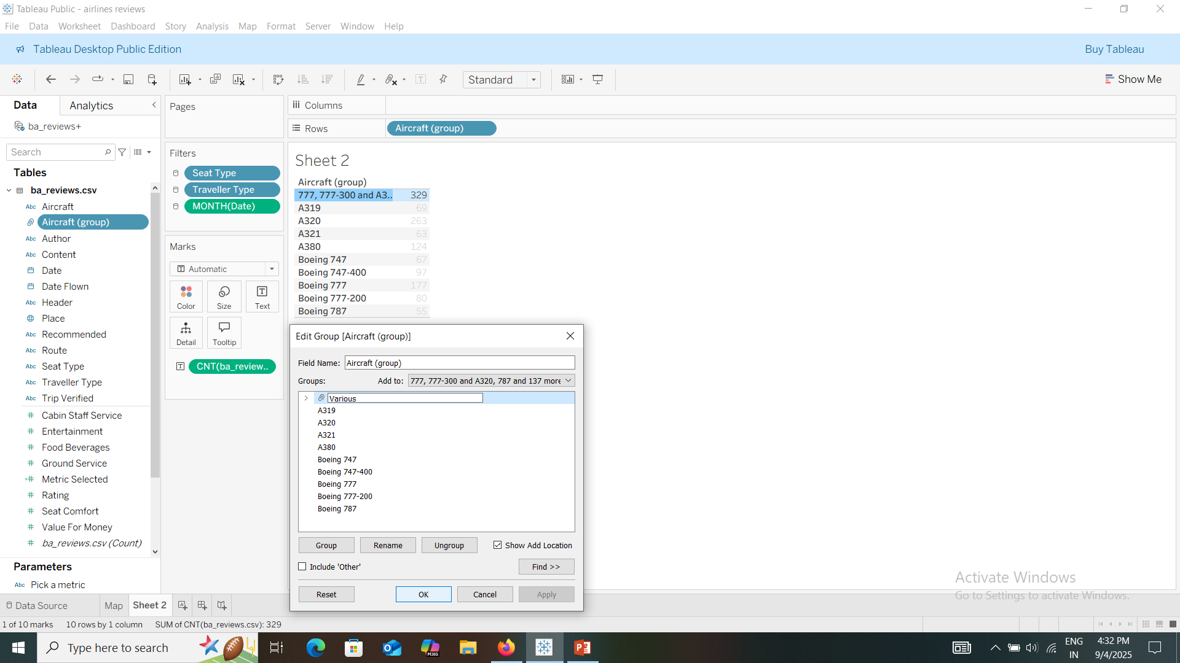
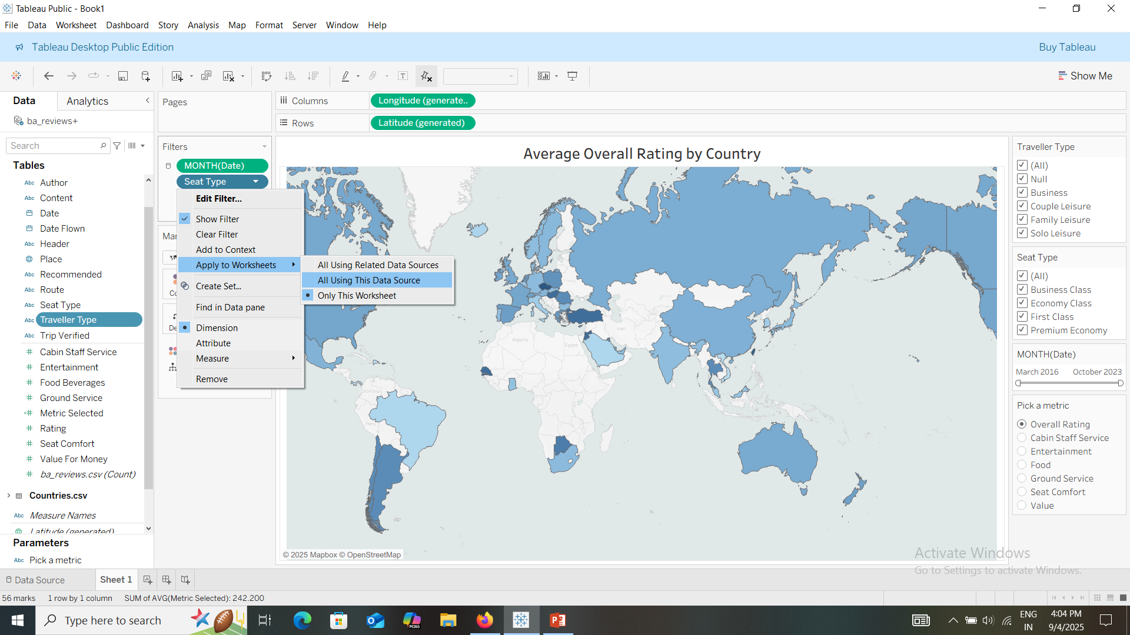
Group the aircrafts with most no of reviews.
Go to map chart and make aircraft group as filter.
Add continent as filter.
Make the filters applicable to all workbooks.

Slide 8
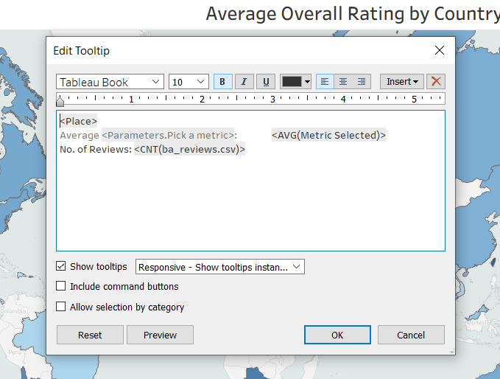
Edit the tooltip
Go to tooltip.
Edit and tidy up the tooltip.

Slide 9
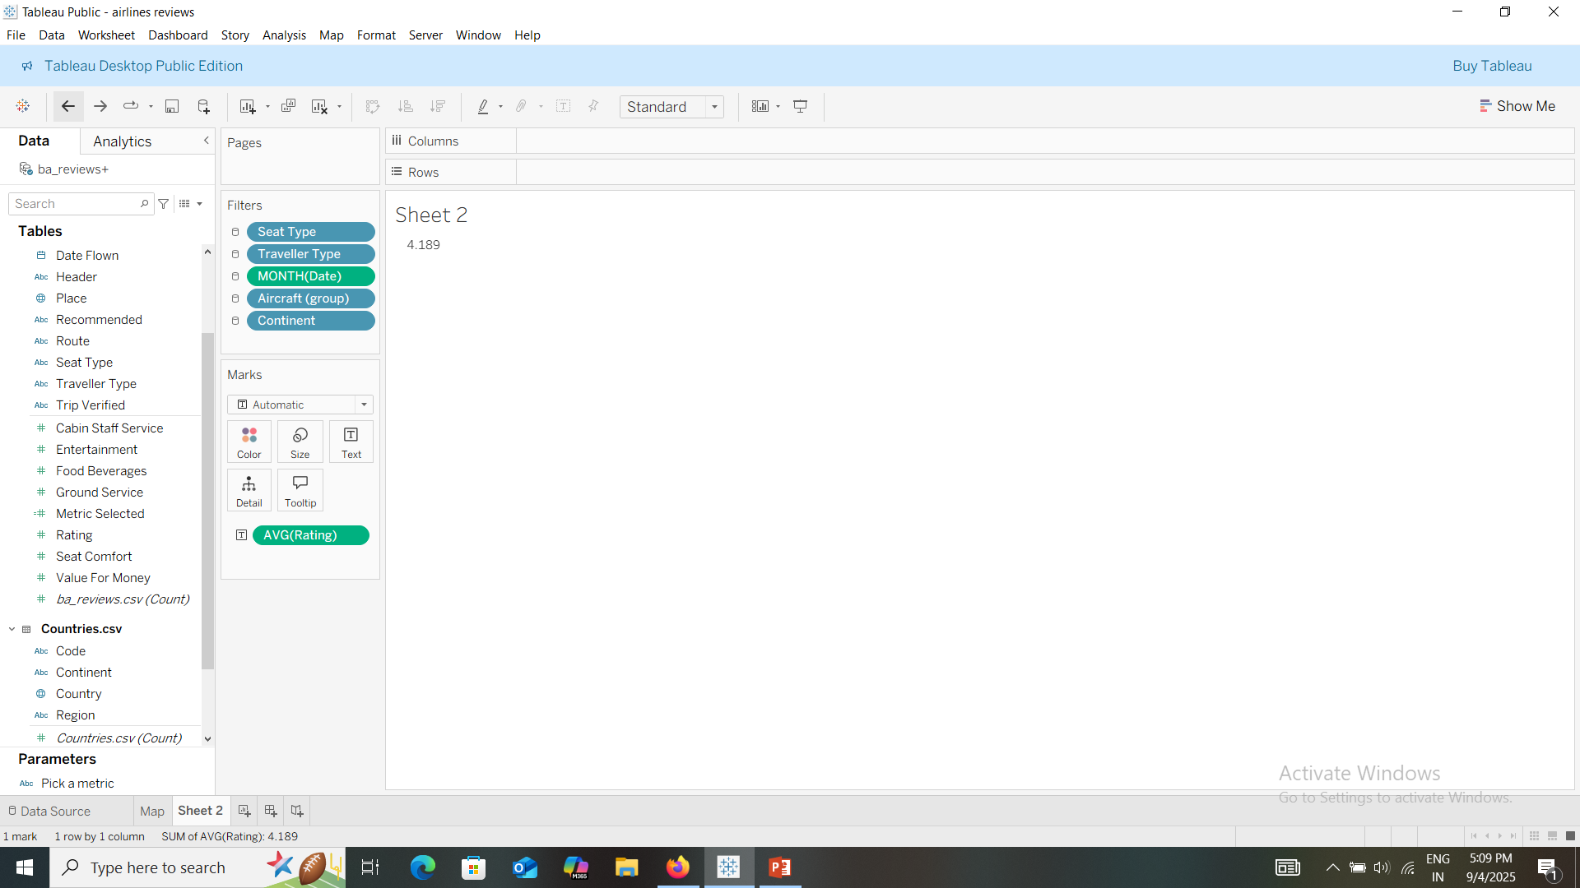
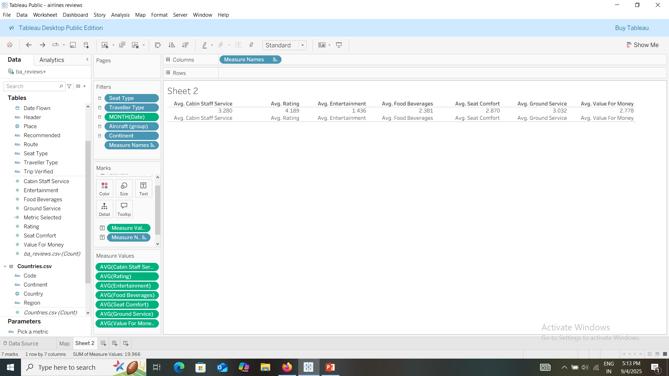
Summary chart
Add rating to text.
Place cabin staff service over avg. rating numbers to create a measure values.
Add other values.

Slide 10
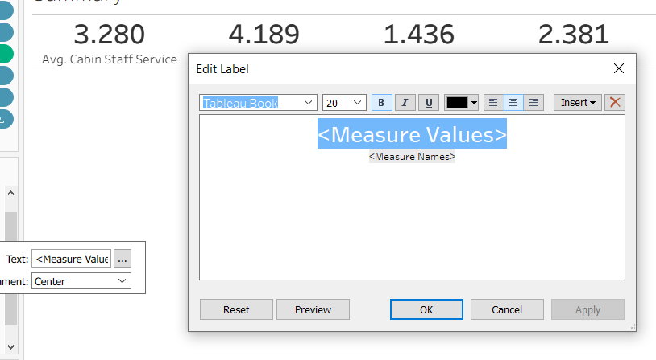
Remove header and align the values in center.
Then edit the label.
Remove the borders and format the decimal places to 1.
Rename the sheet as summary.

Slide 11
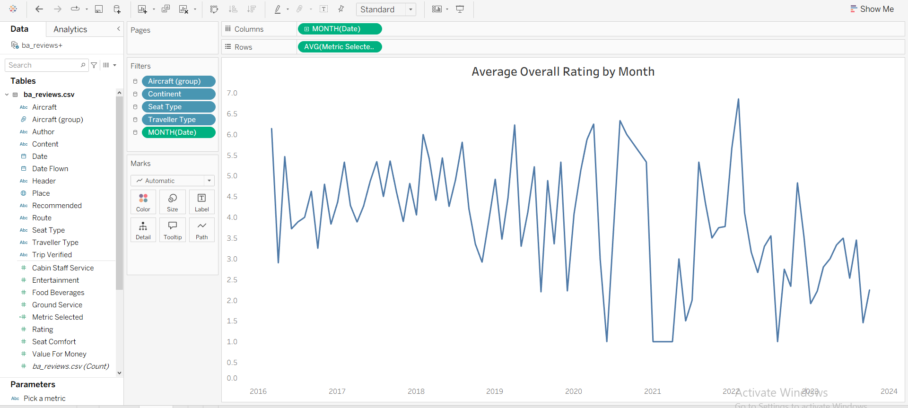
Line chart
Create a line chart using date and metrics selected.
Format and edit the chart.

Slide 12
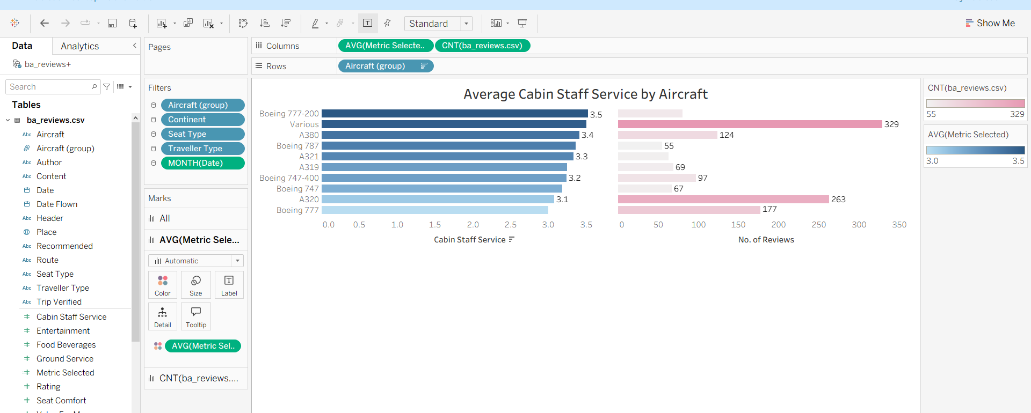
Bar chart
Create bar charts using aircraft group avg metrics selected and count of reviews.
Format and edit the chart.

Slide 13
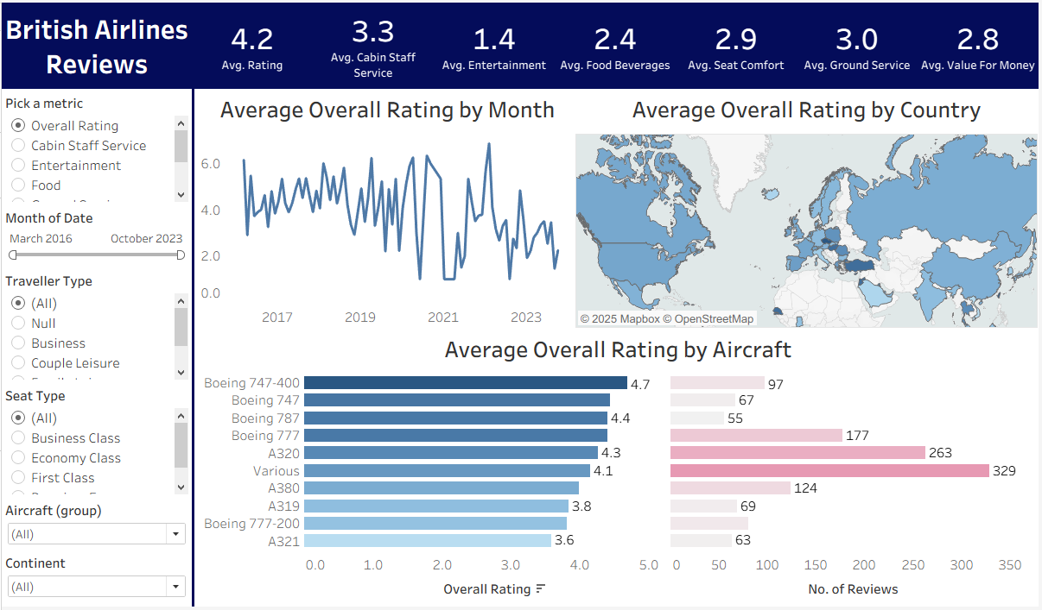
Dashboard
Select dashboard.
Create a floating dashboard and set the charts and filters.
Make all the charts dynamic filters to make it more interactive.

